Slide 2
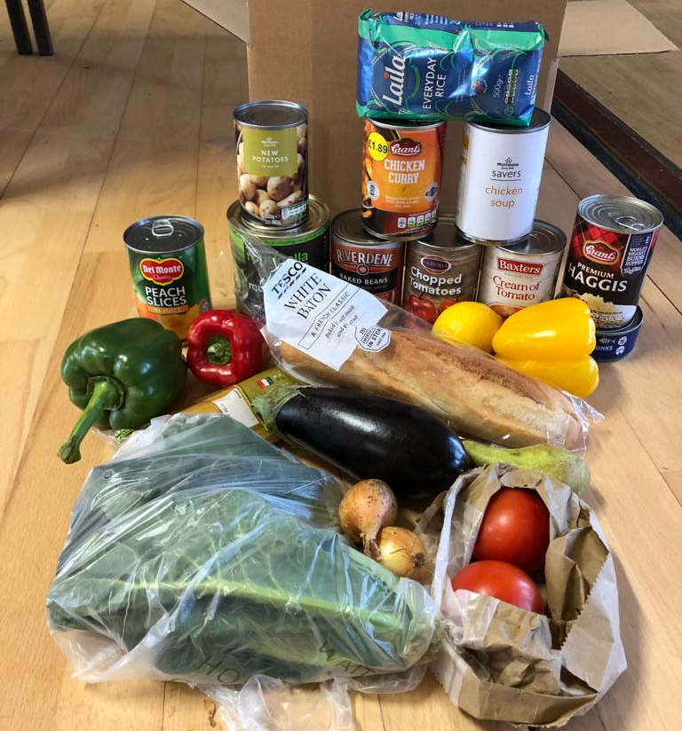
Covid Response
Emergency Food for Households needing help due to:
Health Issues and Shielding
Lack of Transport
Reluctance to Leave Home
Changed Financial Circumstances
Lack of Access to Affordable Food in Rural Communities

Slide 3
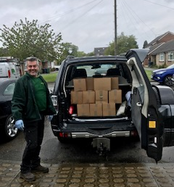
Roade Community Larder
April 2020 – approach to PC to establish distribution hub for free food boxes to households in Roade and surrounding East SNC area
Food funded by NCF, DEFRA in conjunction with SOFEA/FareShare
Brenda Woolf approached to co-ordinate
Grand Union Housing Partnership offered Cripps House
Moved to Village Hall
Roade Bowls Club for Christmas Lunch Hub

Slide 4
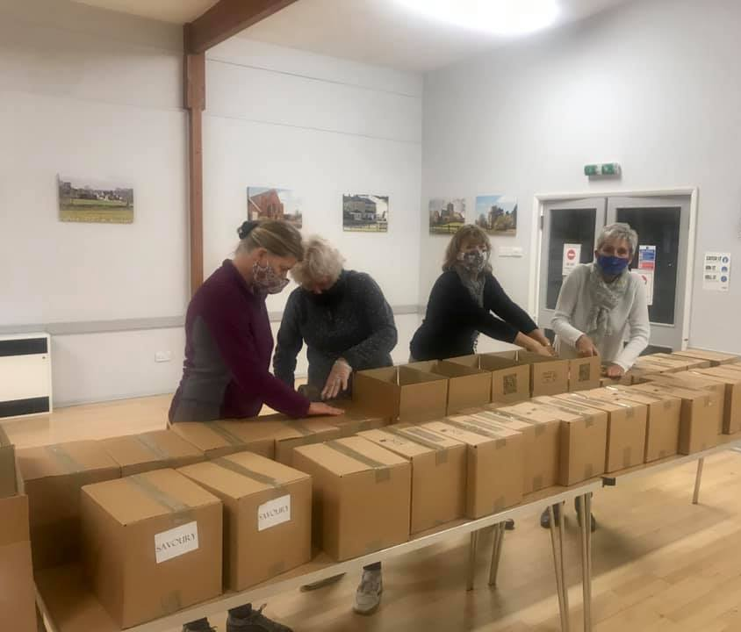
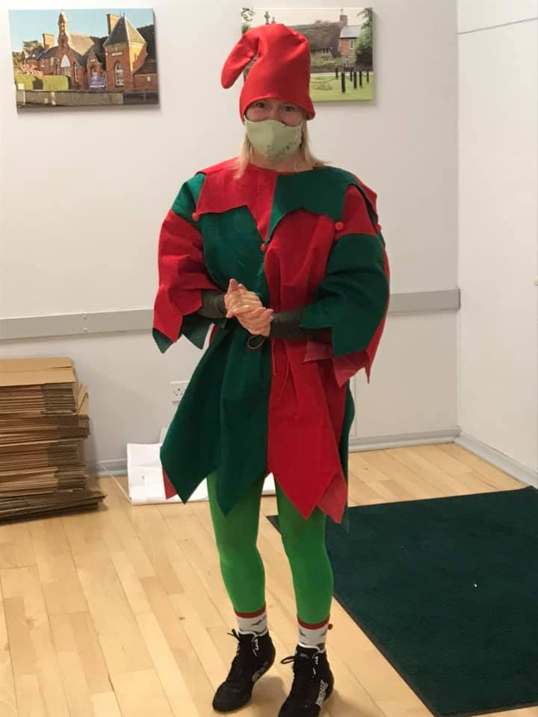
April – August over 1600 boxes packed and delivered
Over 500 went to households in Roade

Slide 5
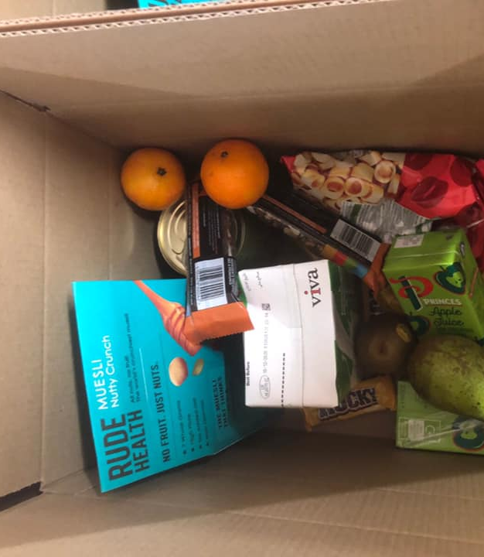
Free Food and Support for Schools
Autumn Term 2020
Marcus Rashford Campaign
Free food for breakfast and after school clubs
Provision of Boxes of Food for FSM and Vulnerable Families

Slide 6
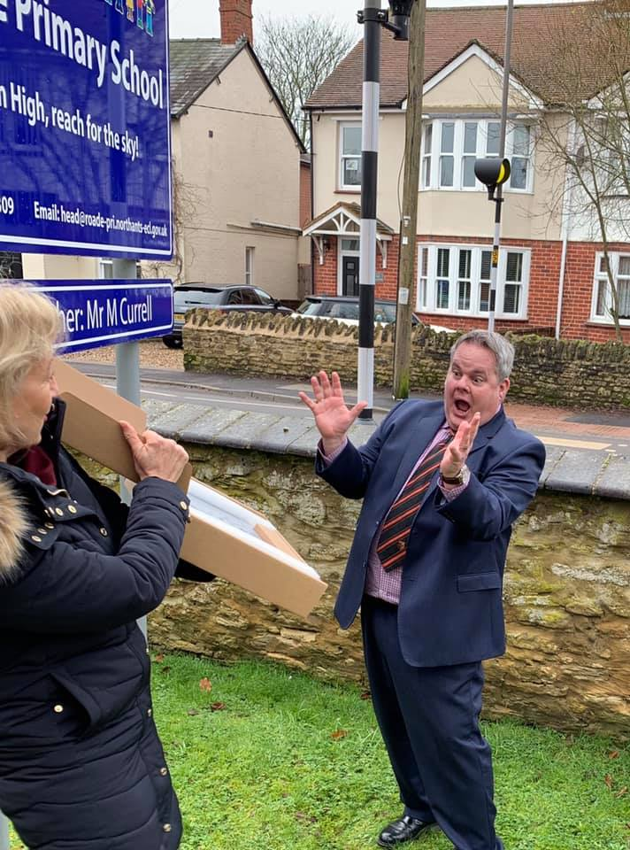
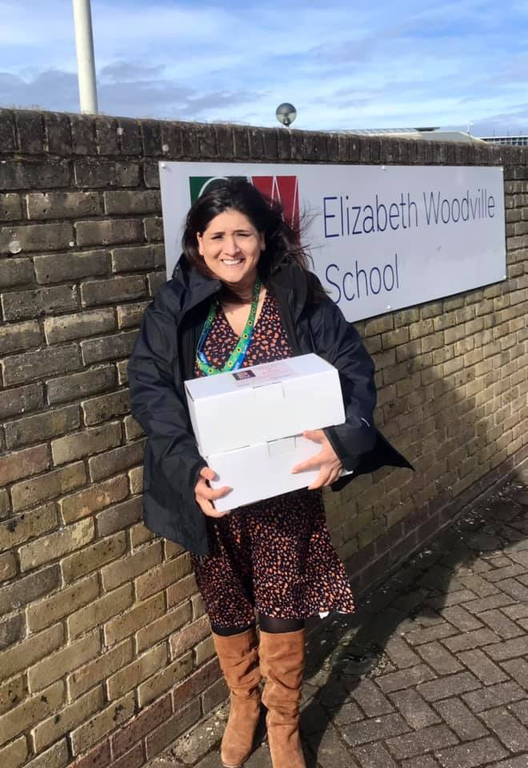
Sept – Nov 2020 we packed and delivered over 1200 boxes of food
Roade Primary and Elizabeth Woodville
Computers for Home Learning

Slide 7
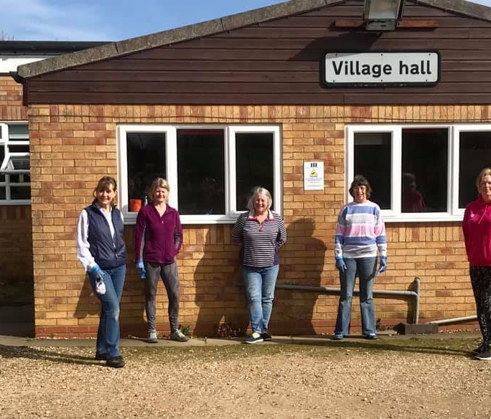
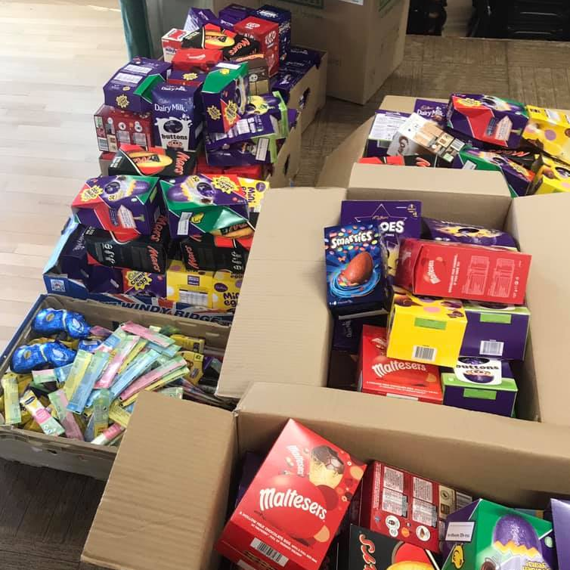
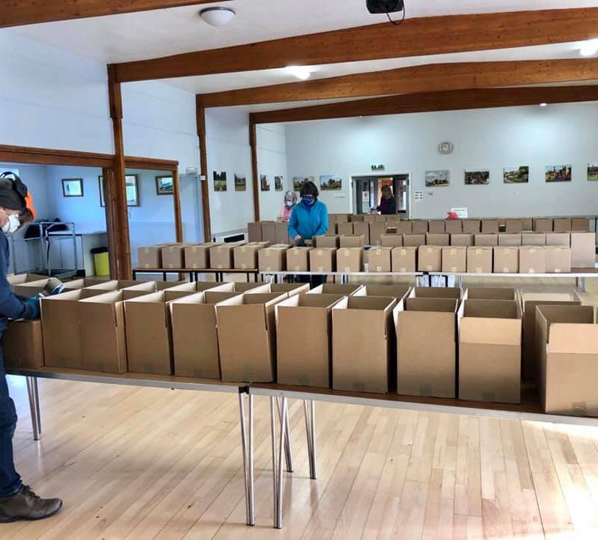
Second and Third Wave Response
November 2020 recommenced support for households in Roade and surrounding parishes
Funding
Volunteers back in action
Nov 2020 – April 2021 over 2000 boxes, around 950 of which went to Roade households

Slide 8
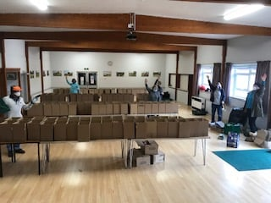
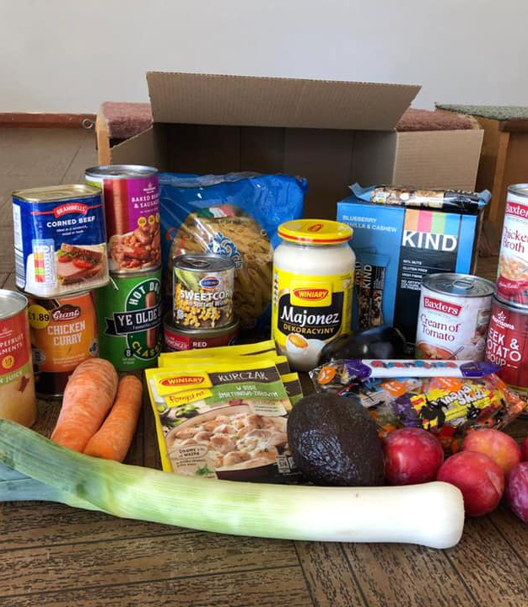
Grand total of nearly 5000 boxes of food over last 12 months

Slide 9
TowFood@Roade – Subscription Community Larder
Monday at Roade Village Hall 1.30-2.30pm
Annual membership
Payment Monthly in Advance or PAYG – from £4 per week
Ambient and Fresh Food
Stops Food Waste
Surplus Food at Vastly Subsidised Rates
Select Own Food
Opportunity to Socialise
Encourages Budgeting for Food rather than Free Handouts

Slide 10
TowFood@Roade – Subscription Community Larder
Over 100 members
Around 50 shopping every week
Most of free food recipients have joined
Social and age mix
Happy customers
Volunteer base includes young adults
Surplus fruit and veg passed on to pigs!

Slide 11
TowFood@Roade Next Steps
Continue to support vulnerable
Expand session to include café, cooking lessons
Establish hubs at other villages
Continue to support access to affordable, sustainable food in rural communities
Extend concept of free fridge and food sharing

