Slide 1
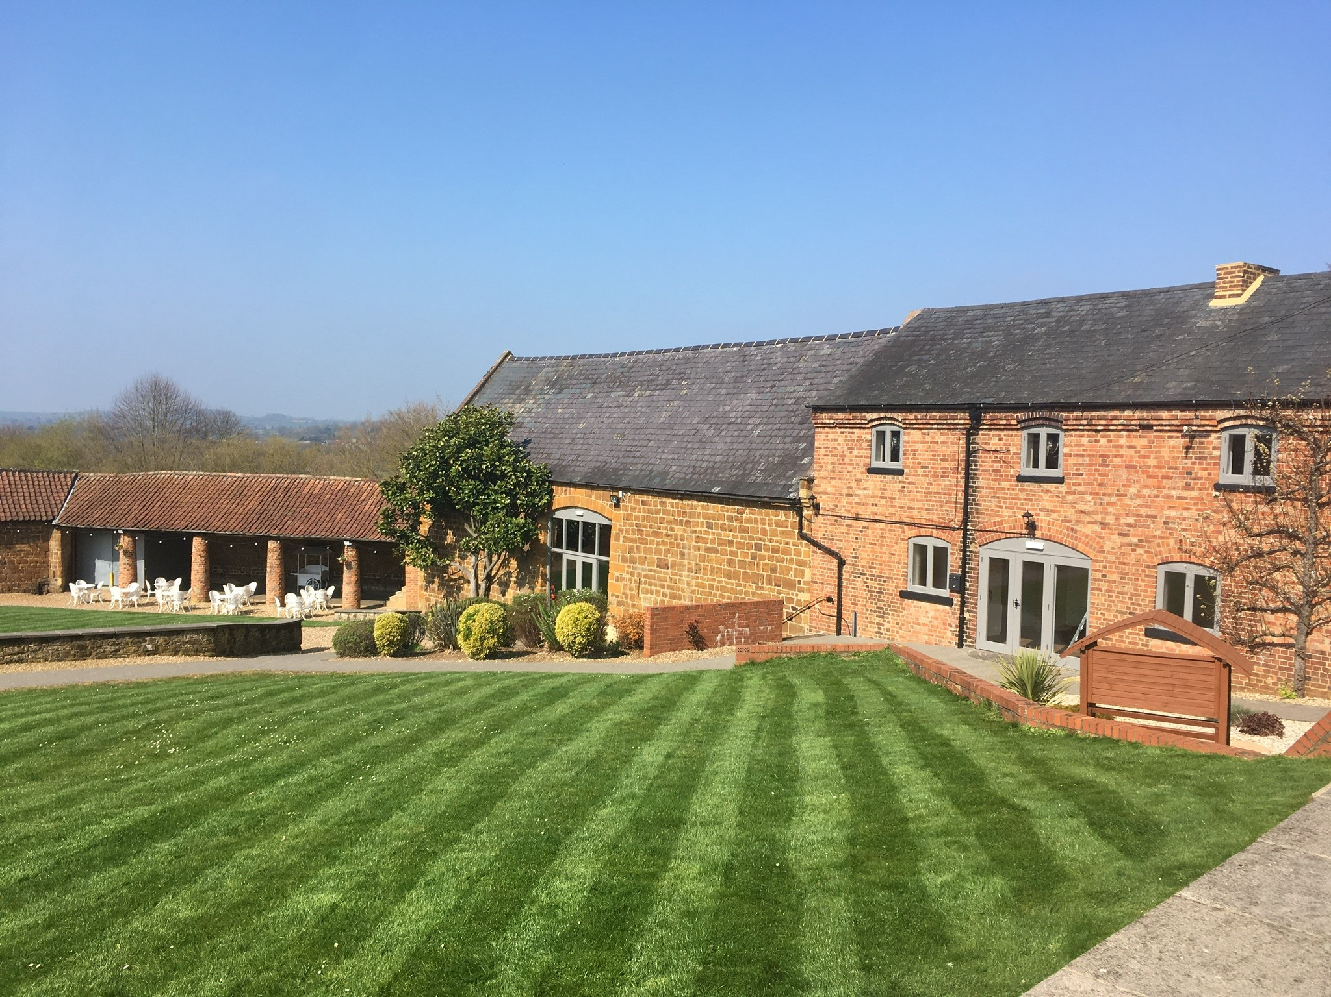
Parish Councillor Network Meeting Wednesday 10th November 2021 Supporting community events

Slide 2
Agenda
Welcome and introductions
Organising Safe Community Events - Jo Maddams, Emergency Planning Officer, West Northants Council
The Queen’s Green Canopy
Coffee Break
Cyber Protect and Fraud Protect – Amie Freeman & David Reed, Cyber Protect Northants Police and Neil McKenzie, Fraud Protect Northants Police
VCSE Assembly representing the voluntary sector
Community funding from Unitary Authorities
Topics for future meetings

Slide 3
Organising Safe Community Events
Joanne Maddams
Emergency Planning

Slide 4
The Queen’s Green Canopy

Slide 5
Plant a tree for the Jubilee
HM Platinum Jubilee in 2022 - https://queensgreencanopy.org/
Encourage tree planting to create legacy
Dedicate 70 ancient woodlands across UK
Identify 70 ancient trees
Woodland Trust is partner and also part of The Big Climate Fightback (to plant 50 million trees to fight climate crisis)
Have Free Trees for schools and communities: https://www.woodlandtrust.org.uk/plant-trees/schools-and-communities/
Villages, Parishes and Towns can get advice on major planting projects through Office of Lord Lieutenant
Pin your Jubilee Tree to the Queen’s Green Canopy map.
Now is the time to plant!

Slide 6
Cyber Protect and Fraud Protect
Amie Freeman and David Reed, Cyber Protect Northants Police
Neil McKenzie, Fraud Protect Northants Police

Slide 7
Next Meeting – September 2021
If you have suggestions for topics that you would like to discuss at future meetings please email details to acre@northantsacre.org.uk

Slide 8
www.northantsacre.org.uk
acre@northantsacre.org.uk
01604 765888
https://www.facebook.com/northantsacre/
@NorthantsACRE

