Slide 1

Eradicate food poverty and food inequality
Increase the profile and importance of healthy eating
Support local farmers and producers
Educate young people about growing and cooking
Encourage the ‘buy local’ theme
Notes:
Two Sustainable Food Networks – one in the West, registered as a sustainable food place and one that I am involved in that operates in the North. We are working hard to build this through collaborative working and have some general aims which fits to the wider agenda I am involved in.

Slide 2


Partnership working is critical
Rachel Mallows, MBE DL
Notes:
We can’t do this alone – conference today has focused on that. Food waste and food sustainability is no different.
Intro
MIN supports local farmers, producers to grow their markets (shops, meet the buyer, networking)
Awards has questions about sustainability in every one of their 15 categories and has done since Weetabix took over as headline sponsor. Chair of NCF and Northamptonshire Surprise and SEMLEP’s Growth Hub. Chair North Northants Foodbank group and Food from England.
We are building partnerships here that will make a difference to our landscape, the food we eat and our health.

Slide 3






Full
Circle
Notes:
MIN and ACRE running the Full Circle Project, funded by CRF and the UK Government.
Mees blueberries in the background?

Slide 4
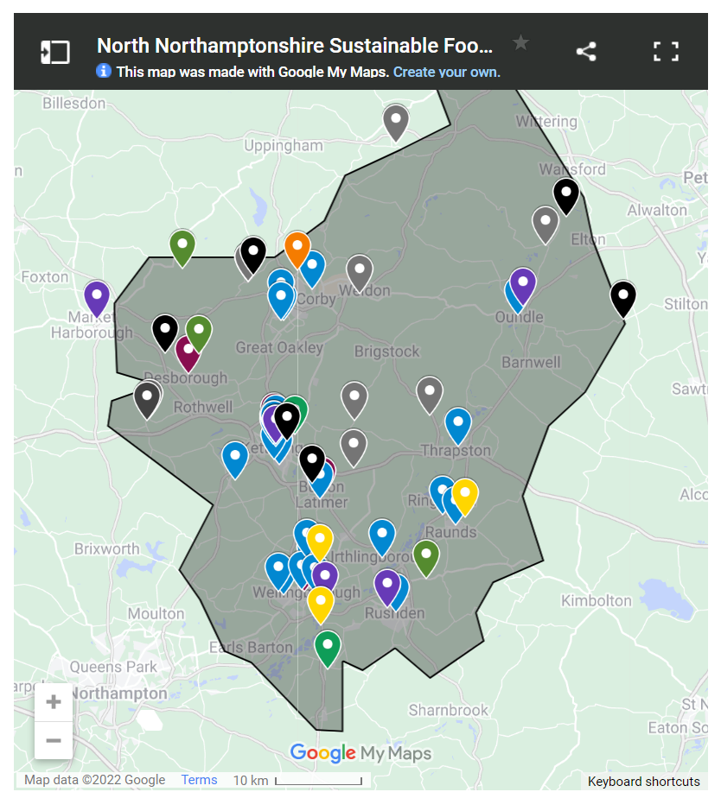
Our Food Map
– Community Cafes
– Foodbanks and Food Larders
– Farm Shops
– Refill Shops and Vans
– Food Waste Reduction
– Community Gardens
– Cafes, Pubs and Hospitality
– Food Manufacturers and Farmers
Notes:
Map to show the range of food – not just producers, but also foodbanks and larders, community gardens….

Slide 5



Notes:
My part has been to work with apps across the North Northamptonshire area.

Slide 6
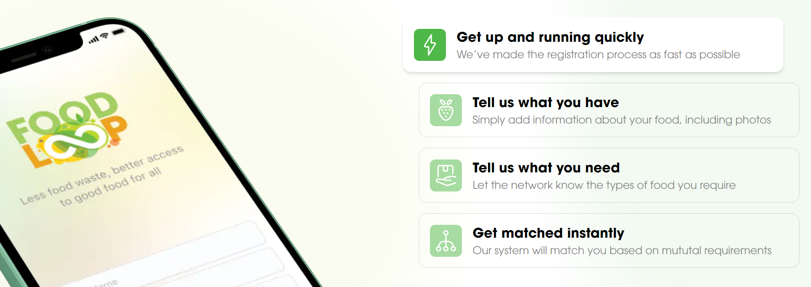
Notes:
Using technology to help solve the problem of food waste – redistributing it to people who need it.
Food Loop – developed by Produced in Kent (similar organisation to MIN) bringing together producers and eateries with foodbanks and others who need food.
Free service to charities. Mainly B2B. Food waste matching

Slide 7
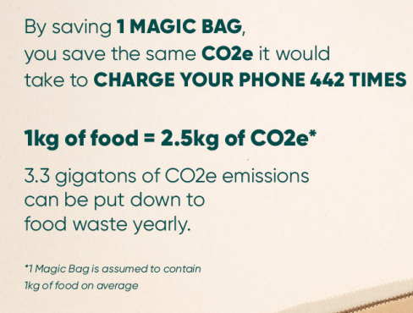
Notes:
Too Good To Go. International app where you purchase a Magic Bag, worth £10 and you can’t choose what is in it but it contains all kinds of things. A real opportunity for restaurants – Business to Consumer offer.

Slide 8
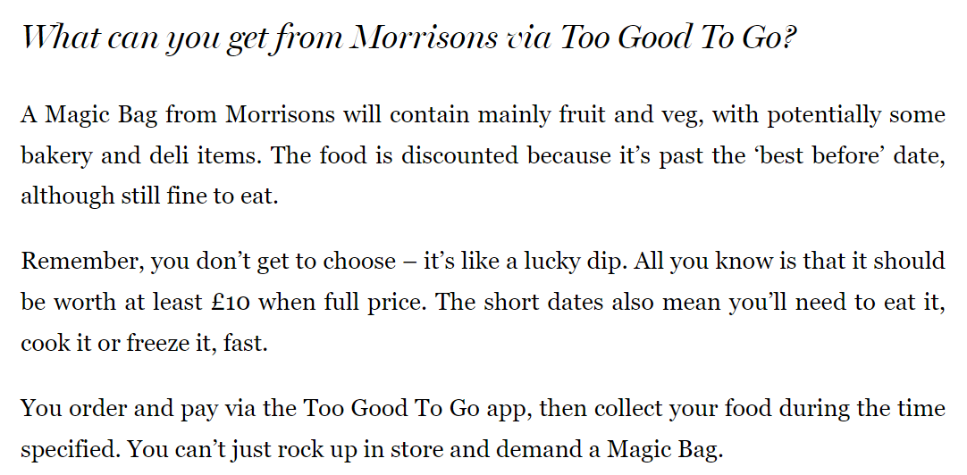
Too Good To Go | Morrisons
Notes:
Here’s what Morrisons are doing with it. We want more places to offer it – and have some free licences to do that.

Slide 9

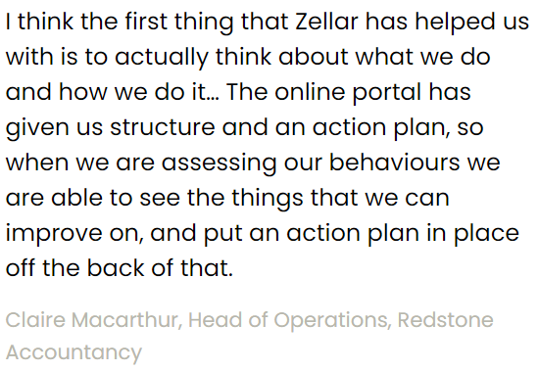
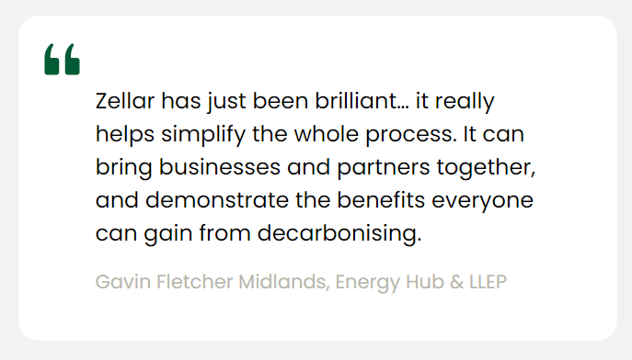
The equivalent of 320 million meals is thrown away every year by restaurants in the UK, five times the population of the UK!
Notes:
Zellar – a way to map out a sustainability journey for a food and drink associated business. Lots of apps doing this at the moment but this is the most widely used with LEPs and other local government bodies, so we are hoping for some comparative data. It doesn’t compete with others such as B-Corp, as it covers a wider remit. Of those registered at the moment nearly half have submitted building emissions and a quarter travel emissions submitted. Similarly we have some free licences available for this.

Slide 10
How can you get involved?
Notes:
This doesn’t work unless we get involved. The food is there – waste or unwanted food – we have to act, to participate in the act of passing it on to make a difference. We are brought up to do that at harvest time at school and in faith communities.
If you are involved in food in some way please contact us to register on the map, or talk to us about the app. However you are here please think about what you can do to help us promote this message to grow, cook, share, sell, eat and cherish our local food and drink.

