Slide 1
Tuesday 25th February 2020
Parish Councillor Network Meeting

Slide 2
Elaine O’Leary
Jennifer Hedges

Slide 3
Lessening the impact of climate change on your village/becoming carbon neutral
Climate change occurs when changes in Earth's climate system result in new weather patterns that remain in place for an extended period of time. This length of time can be as short as a few decades to as long as millions of years.
Carbon neutrality, or having a net zero carbon footprint, refers to achieving net zero carbon dioxide emissions by balancing carbon emissions with carbon removal (often through carbon offsetting) or simply eliminating carbon emissions altogether (the transition to the "post-carbon economy").
About three-quarters of greenhouse gas emissions that are attributed to humans come from burning fossil fuel

Slide 4
Ways of helping
Recycle and reuse
Reduce fossil fuel use
Carbon off setting – if net emissions equal zero, then carbon neutral
Increase biodiversity
Encourage energy efficiency measures in homes
Use of carbon calculator
Develop a environmental strategy for your community

Slide 5
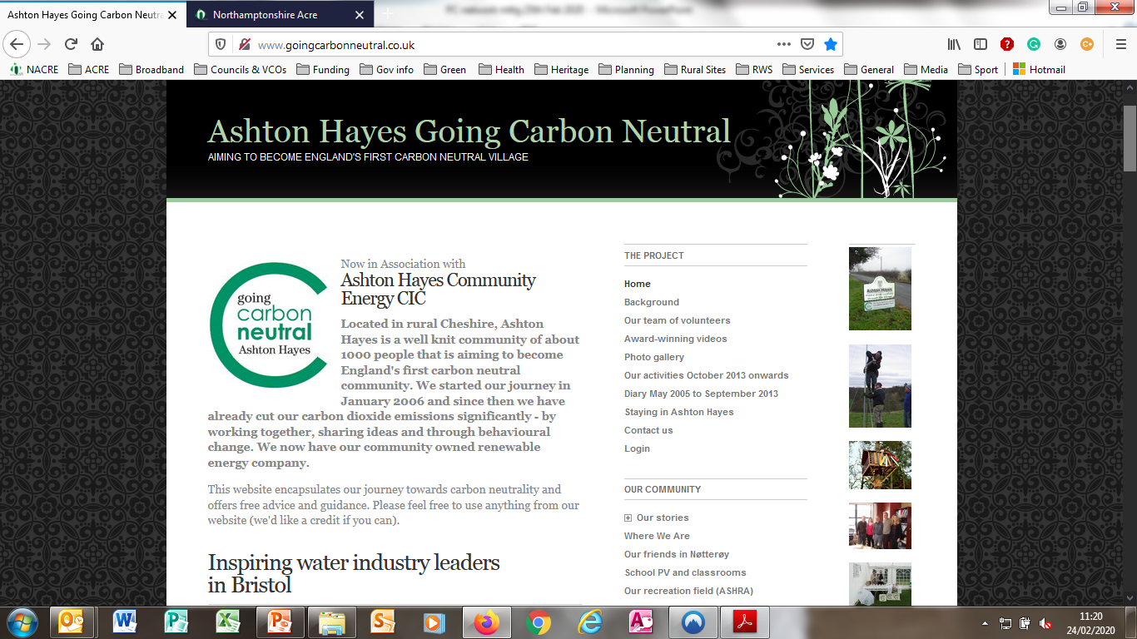

Slide 6
Ashton Hayes
Started with one person, Gary Charnock
He proposed the village should try to become carbon neutral.
November 2005 Parish Council voted to adopt the proposal
26th January 2006 first meeting – 400 people attended (75% of pop)
First step, Uni of Chester carried out survey of all residents to find out their carbon useage with a carbon calculator
5 surveys later show community cut its carbon emissions by 40%

Slide 7
Ashton Hayes
Some residents cut bills by 50% - improved insulation, careful energy use and saved money
Village now linked with over 1000 communities around the globe
2010 one of 22 communities funded under DECC's Low Carbon Communities Challenge
£400k grant built low carbon sports pavilion complete with Solar PV array that help to fund the maintenance of the pavilion and field.
To manage the 'business side' of village operations they have formed the Ashton Hayes Community Energy - a Community Interest Company (AHCE CIC)

Slide 8
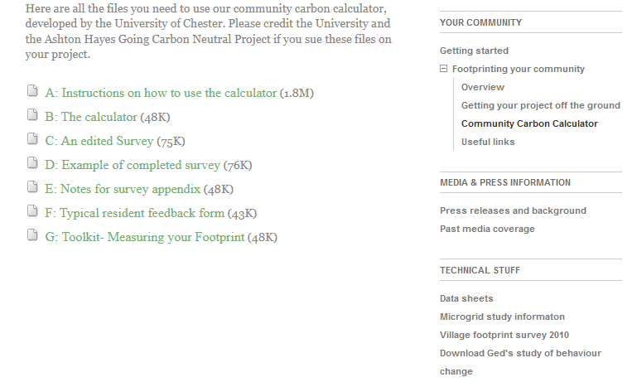
Community Carbon Calculator
University of Chester developed a community carbon calculator
If you use it please credit Uni of Chester
If you would like to know more go to Ashton Hayes website:
http://www.goingcarbonneutral.co.uk/

Slide 9
What can you do?
Not everyone can be like Ashton Hayes, but small steps help
Start with the calculator – it can help people to save money
Look at biodiversity of village: encourage green spaces, more natural planting, rewilding of areas!
Joined up bus services with other villages
Encourage residents to shop locally or arrange one delivery to many
Encourage rainwater butts in each garden, community compost bins
Make use of the many websites and projects already running
Flooding is a real issue at present: Northants CC flood awareness toolkit can help

Slide 10
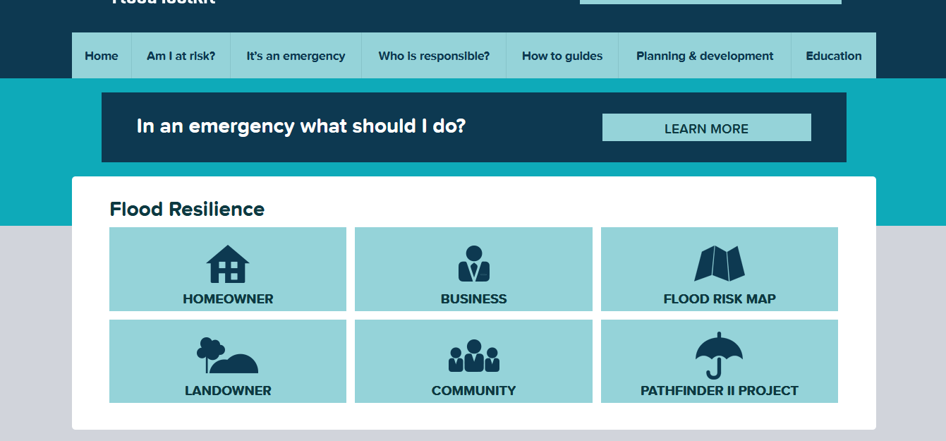
Northants Flood Awareness Toolkit
Northants is a Pathfinder county. NCC given funding to set up a flood awareness toolkit
Been available for several years
‘How to guides’ free to download
https://www.floodtoolkit.com/

Slide 11
Useful sites
Community orchards:
https://assets.publishing.service.gov.uk/government/uploads/system/uploads/attachment_data/file/11466/1973262.pdf
Street Lighting: interest free funding for public sector lighting:
https://www.salixfinance.co.uk/loans/street-lighting
Rural community energy fund for large scale renewable projects:
https://www.gov.uk/guidance/rural-community-energy-fund
Zero waste shopping at Flore:
https://coffeeandrefills.com/

Slide 12
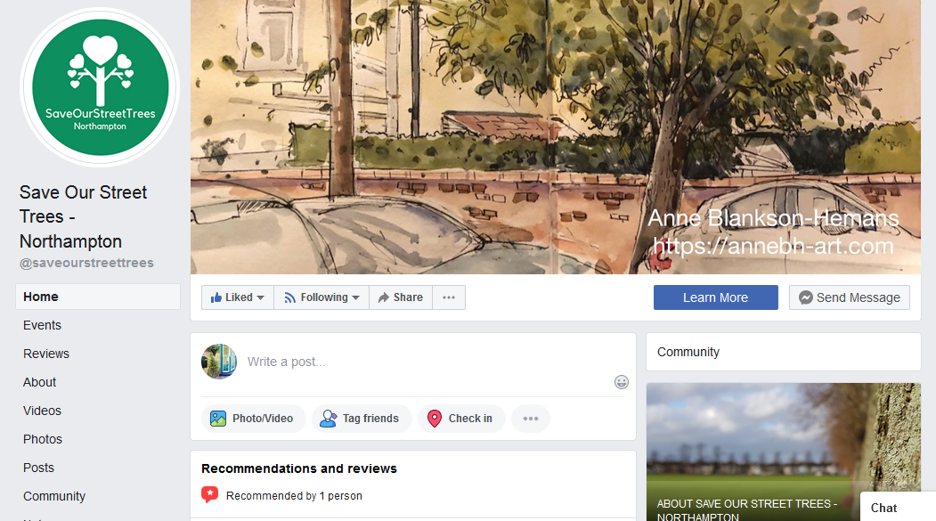
Street trees
Street trees:
https://www.facebook.com/saveourstreettrees/
Right Tree, Right Place
http://www.righttrees4cc.org.uk/members/Search.aspx
Soil mapping:
http://www.landis.org.uk/soilscapes/

Slide 13
Making Local Woods Work
If you have small woods to maintain or want to develop one:
Making Local Woods Work was a pilot project that aimed to support and grow woodland social enterprises across the UK.
The project was funded by the National Lottery through the Big Lottery Fund and led by Plunkett Foundation as well as range of partners.
Finished in September 2019 but lots of ideas on website:
https://www.makinglocalwoodswork.org/

Slide 14
Communities Prepared
Communities Prepared is a nationwide community resilience programme, which equips communities with the knowledge and tools to effectively prepare for, respond to and recover from, emergencies such as flooding, snow, other severe weather events and utilities failures.
Led by Groundwork South and in partnership with the Environment Agency, Cornwall Community Flood Forum and Cornwall College Business
Our Rural Officer, Jenni Hedges, is a Communities Prepared trainer and can offer training to help your community
Contact her for more details.

Slide 15
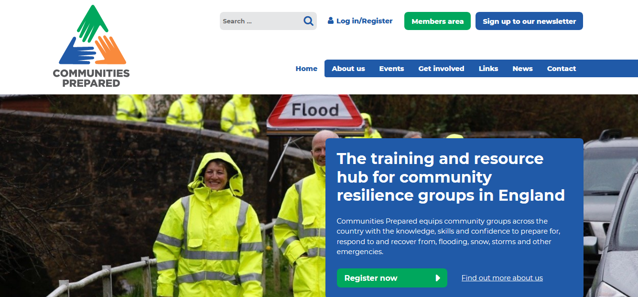
Communities Prepared
Communities Prepared website:
https://www.communitiesprepared.org.uk/

Slide 16
Further Details:
If you need additional information or there is anything further you want to know please contact :
Jenni Hedges, Rural Officer
T. 01604 825884.
E. jennifer.hedges@northantsacre.org.uk
W. www.northantsacre.org.uk

