Slide 1
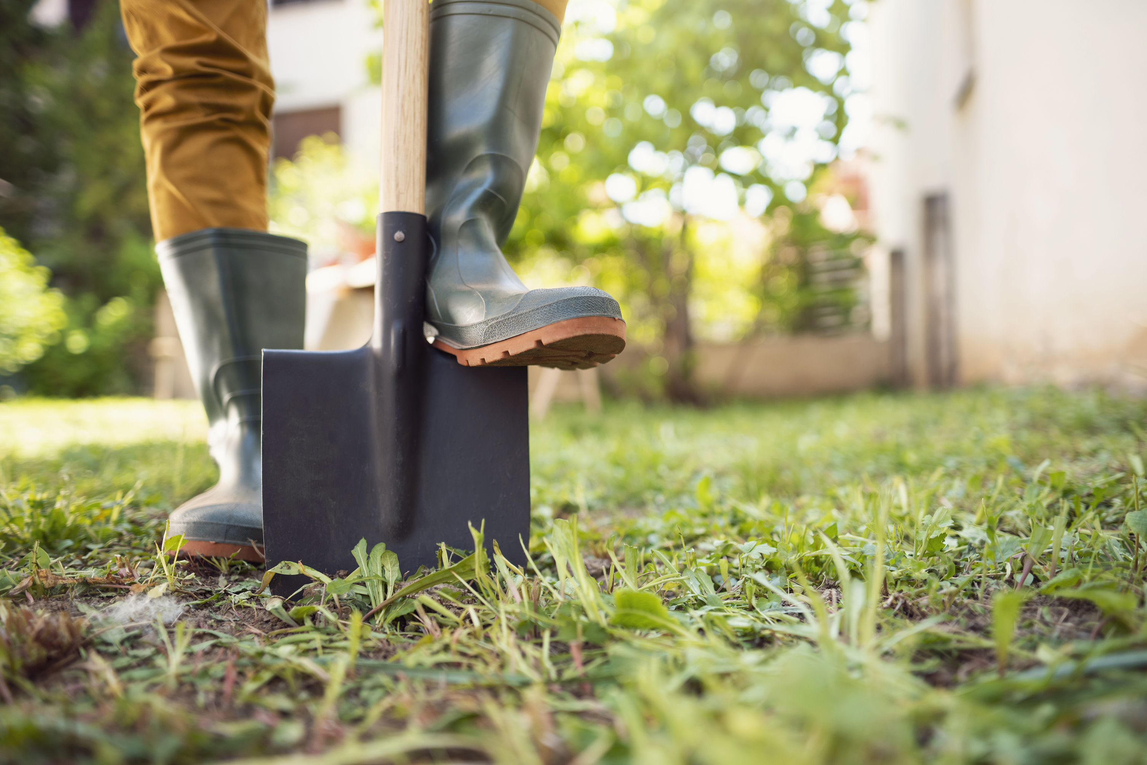
Cooking and Growing Fund – West Northants
A project designed to help people grow, cook and eat more healthily
has been launched by HOPE and Health-Works with funding from Public Health Northamptonshire.

Slide 2
What’s it all about?
Partners
Champions
(& Training/ support for them)
Grants

Slide 3
Partners
FAAWN Alliance
Sustainable Food Places West Northants
West Northants Community Growers
Health and Wellbeing Board(s)
NHFT
Housing Associations - GUHG, NPH (others) Housing team in West Northants Coucil
Resettlement Team
Social Prescribers
Primary Care Networks/ CCGs –
WNC Wellbeing teams for each locality
Snvb, Daventry Volunteer Bureau and others Northants ACRE
Strengthening Families Team
MIND, Talk Mental Health and others
Leisure Centre Groups
And more...
&
Working in partnership with...

Slide 4
Champions & Support
..................
40 cooking and growing champions recruited
..................
40 training days;
100 mentoring support days
.................
A network of champions created;
1500 end recipients

Slide 5
Grants
Approx 45-50 grants for cooking and growing projects*
*Amounts for grants can be small (few hundred - to a few thousand ££s)
Sustainability is key

Slide 6
Target areas
Northampton:
St David's
Kingsley
Spencer
Billing
Westone
Castle
Brookside
Talavera
Headlands
St James
South Northants:
Brackley West
Kingthorn
Daventry:
Drayton
Weedon

Slide 7
Timeline
Nov – Dec 22
Needs mapping completed
2 year project plan created
Webinars to introduce programme
1st round of grants completed
Initial training and mentoring for first cohort activated
On-going consultation with key partners
Sep – Oct 22
Coordinator recruited
Small grants scheme developed and promoted
Develop and promote training programme
Coordinator induction
Finalise branding and communications
Key measurement tools developed
July – Aug 22
Contract signed & partnership established
Consult key partners & social media (for name)
Coordinator advertised
Budget process in place
Press release drafted
Public Health establishing oversight board

Slide 8
Contact
Louise Danielczuk
Fundraising and Marketing Manager, Northampton Hope Centre
louise@northamptonhopecentre.org.uk
Lorraine Hirst
Founder and Director, Community Health-Works UK CIC
lorraine@health-works.co.uk
Info about organisations:
https://www.northamptonhopecentre.org.uk/
https://goodfoodwnorthants.org/wnorthantscommunitygarden.html
www.cooking-good.co.uk
www.health-works.co.uk

