Slide 1
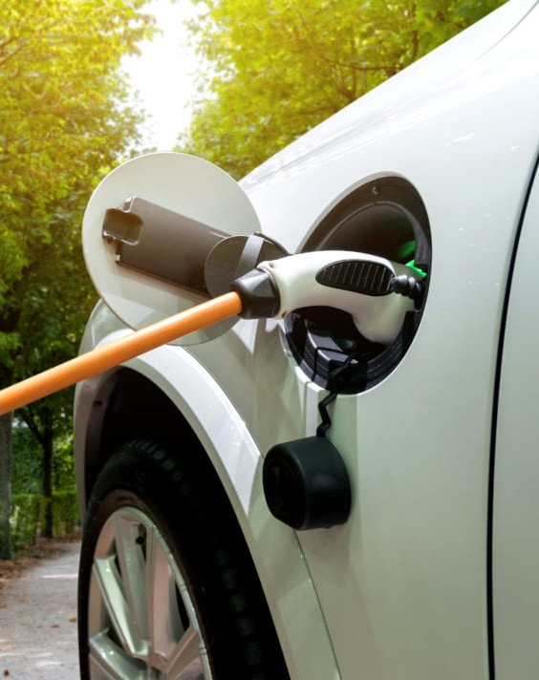
Our First Pledge
Net Zero own emissions by 2030 and those of residents and businesses by 2045

Slide 2
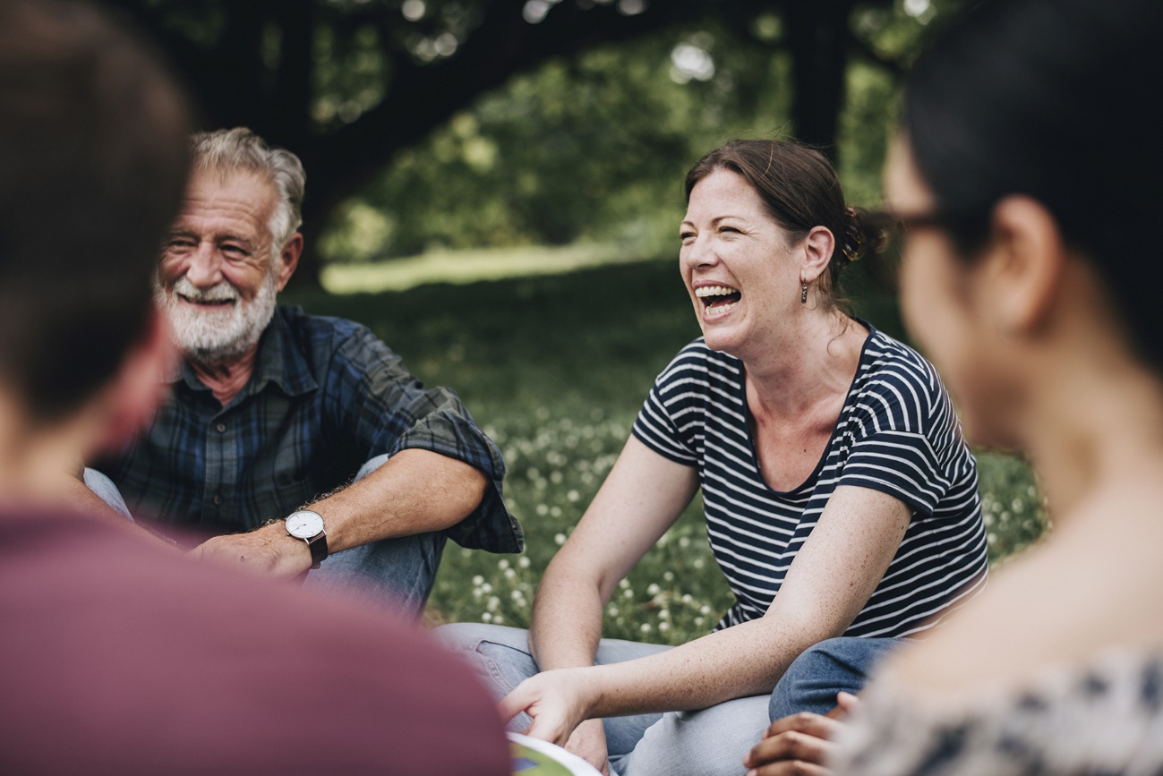
Our Second Pledge
Take a community leadership role for Sustainability in West Northants

Slide 3
Our Third Pledge
Ensure all our Council strategies and policies are aligned to and contribute to the delivery of the UN SDGs

Slide 4
Encouraging residents and businesses to make sustainability pledges

Slide 5
Sustainability Team
We have recruited new members of staff and established a team dedicated to delivering sustainability

Slide 6
Thank you
Questions?

