Slide 1


Welcme
Cllr Jonathan Nunn
Leader of the Council
West Northamptonshire Council

Slide 2


A bold new approach
‘To protect and
improve West
Northants for
future generations’

Slide 3

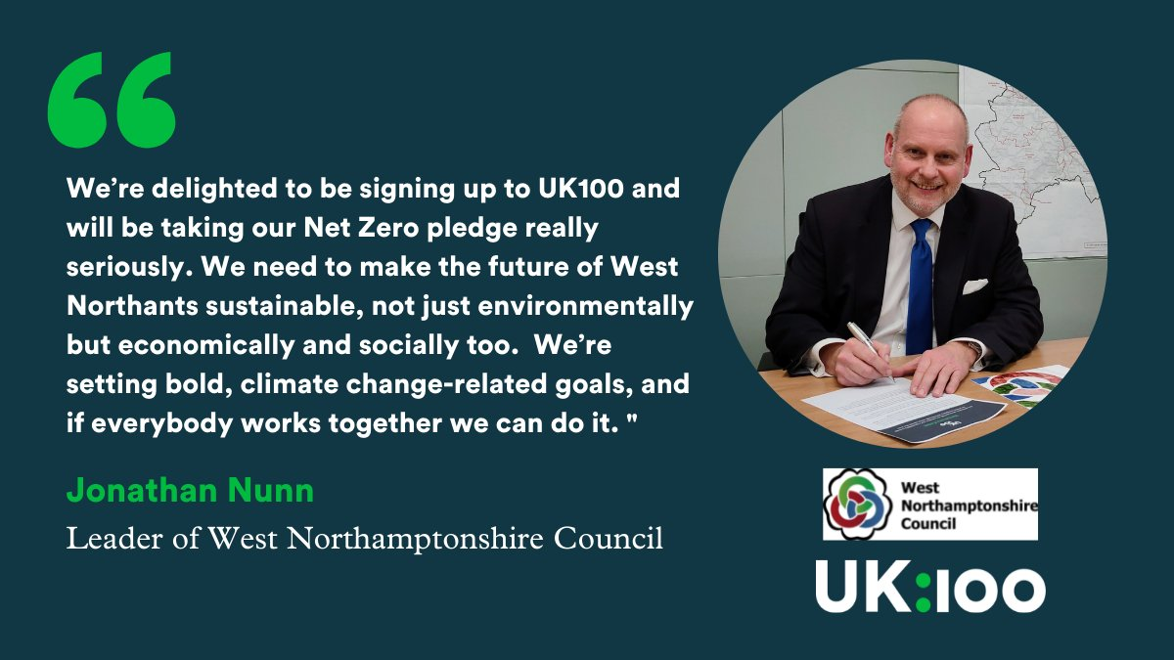
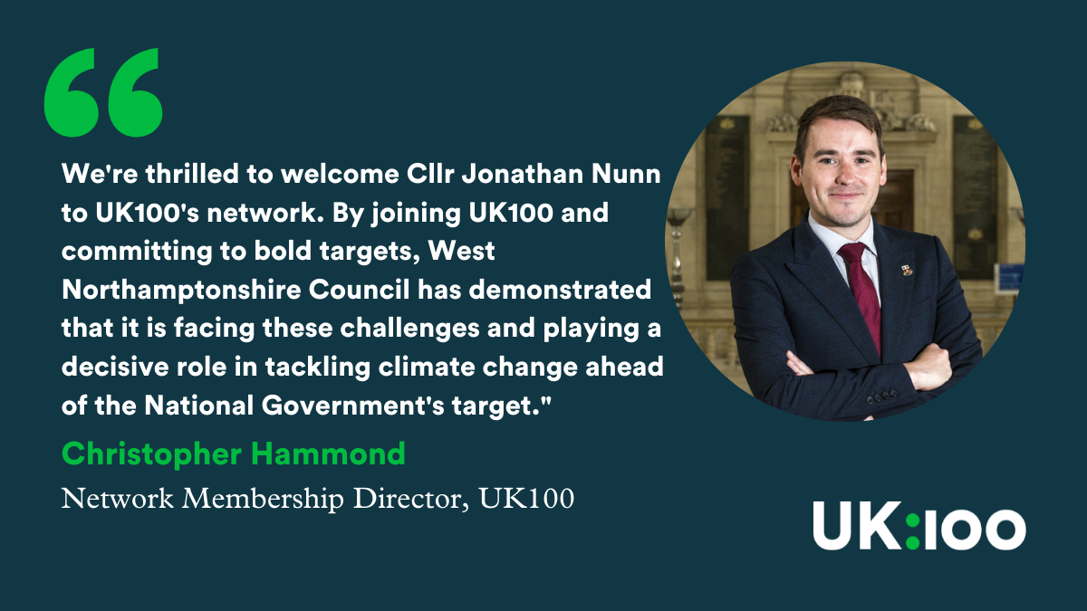

Slide 4

Sustainability
“Meeting the needs of the present without compromising the ability of future generations to meet their own needs.”
United Nations Brundtland Commission 1987

Slide 5

The United Nations’ Sustainable Development Goals

