Slide 1
Good Neighbours Scheme
Joanna Browning & Claire Yow

Slide 2
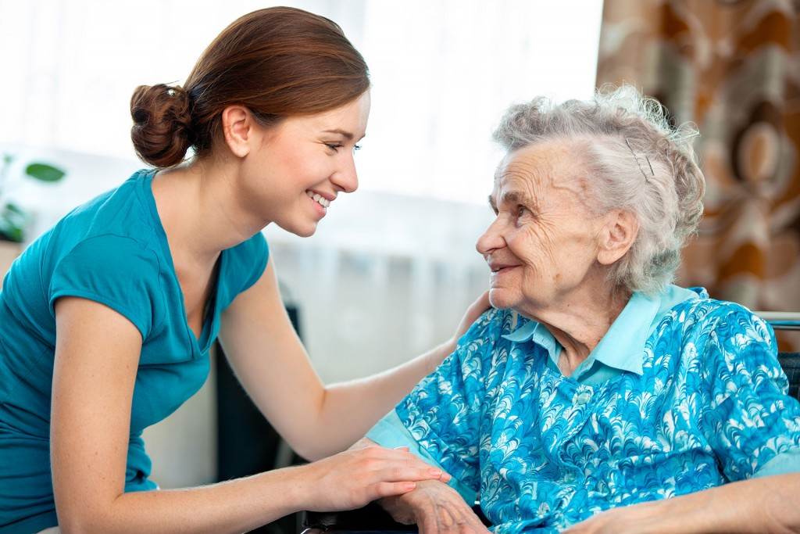
Low level support on an occasional or regular basis
Reducing loneliness & isolation, helping extend independent living in homes people love

Slide 3
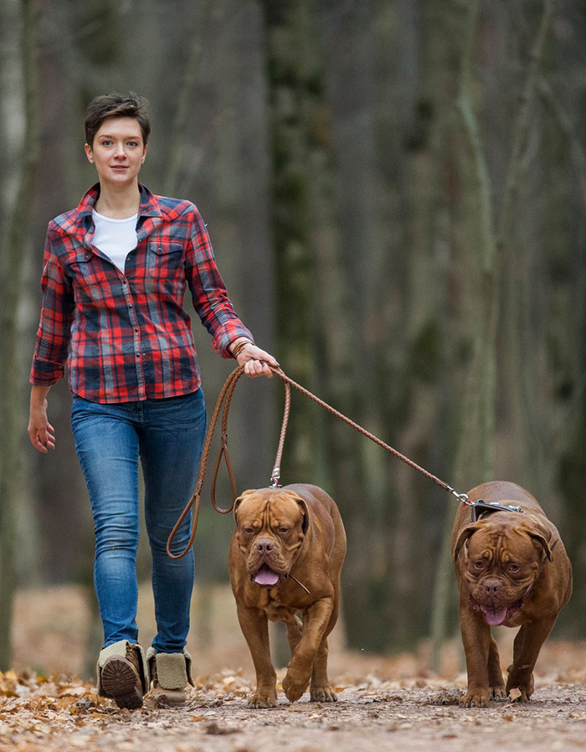
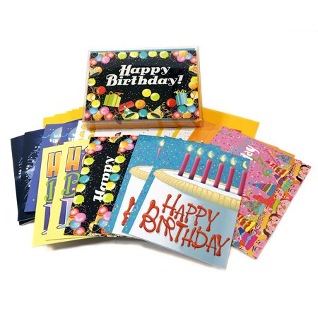
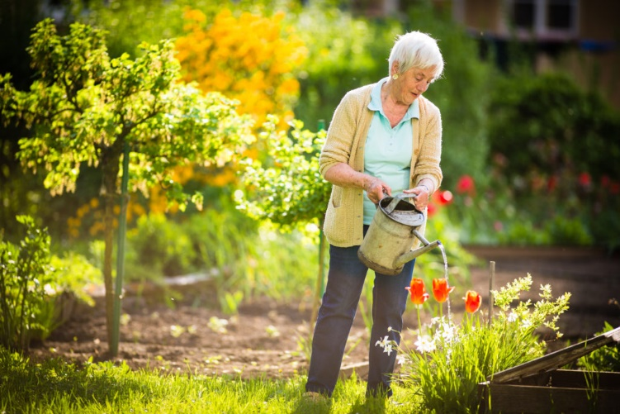
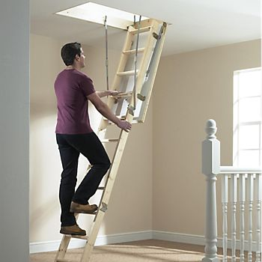
What can we offer?

Slide 4
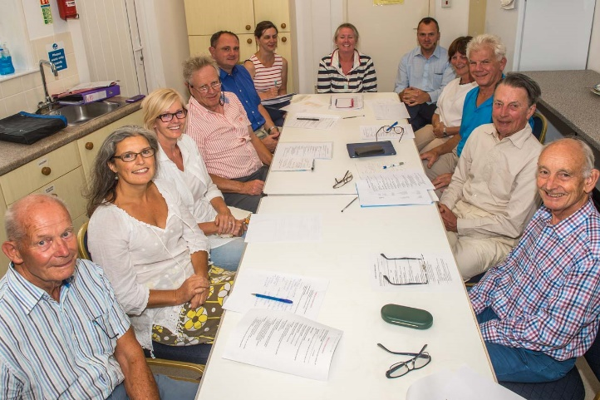
UNIQUE
5
Steering group?
Committee?

Slide 5
How it works
Have Co-ordinator/Duty Officer who has a mobile phone and details of all volunteers, what they offer and when.
Any resident in genuine need of help can ring the number
The Co-ordinator will identify an available volunteer who can provide the help and contact them
Volunteer will contact resident to arrange time of visit
Can also signpost to voluntary/charity and statutory organisations or professional company if the need is outside of a volunteer remit **

Slide 6
Scheme organised by small steering group:
Determine need and capacity
Recruit volunteers
Decide scope of scheme i.e. what is offered
Get funding and insurance
Arrange training and DBS checks if needed
Purchase mobile phone, laptop if required
Assist in setting up activities and events
Help is given to those in need free of charge although a reasonable charge can be made if a volunteer’s car is used.

Slide 7
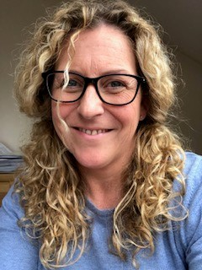
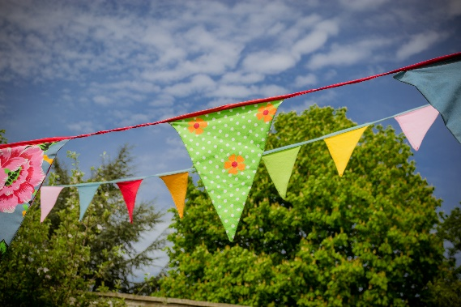
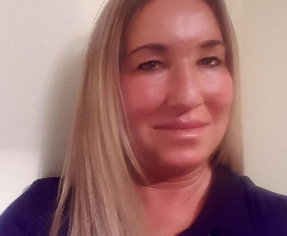
NLCF Good Neighbours project
National Lottery Community Fund providing over £272,000 for 3 years
To set up and support 30 Good Neighbour schemes across Kettering, Corby, Wellingborough and East Northants.
Covers 2 full time field workers to help set up the schemes and support them
Up to £700 available to each scheme for set up costs
Good Neighbour annual event

Slide 8
Other areas
For Daventry- Northants ACRE are working with Daventry District Council- Funding is available for up to £700
For Northampton- Northants ACRE is working with VIN (Voluntary Impact Northamptonshire and funding is available to meet some costs) to cover the parishes and more urban groups.
For South Northants- Northants Acre are working with South Northants Council but their funding has stopped ahead of unitary- Northants ACRE will support new groups to apply for alternative funding.

Slide 9
Setting up a scheme
Identify need and volunteers through survey
A steering group (2 to 4 volunteers)
A constitution
Bank account – it should be separate to the Parish Council.
Insurance
Mobile phone
Laptop
Marketing & publicity materials
DBS checks for volunteers
Training.

Slide 10
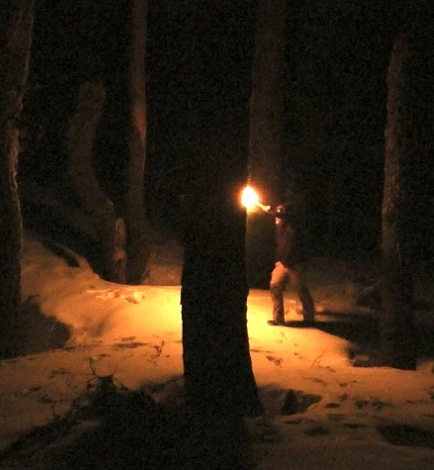
This Photo by Unknown Author is licensed under CC BY

Slide 11
How NACRE can help

Slide 12
I already run a community group, can I become a Good Neighbour Scheme?
Yes, we welcome existing neighbourhood groups to join the network and access help and support.
You do not need to change the name of the group, or your community offer, all we ask is that you have a constitution and bank account (so you can access funding) and that you have a safeguarding and equal opportunities policy.
We do not interfere or take over a group- the group will still be managed and run by the community- we are just here to help and support if needed.

Slide 13
Why?

Slide 14
www.northantsacre.org.uk/good-neighbour-schemes
acre@northantsacre.org.uk
https://www.facebook.com/northantsacre/
https://twitter.com/NorthantsACRE

