Slide 1
Creaton Village Shop They are on their way!
Richard Hollingum
Creaton Community Benefit Society

Slide 2
A bit of history
Notes:
Small village in Daventry District
500+ in 210 houses
100 years ago several shops
Within living memory, two shops and a butchers
For past 20 years or so, one shop/PO

Slide 3
More recently
Notes:
Current owners planed retirement three years ago and put the business on the market
No purchasers – house and shop
Change of use through planning

Slide 4
In the beginning...
Parish Council-led village meetings
Plunkett Foundation
Northamptonshire ACRE
Informal group
Notes:
At this point the PC arranged a number of village meetings which included Plunkett and NACRE
After the last of these meetings an informal group started up

Slide 5
Creaton SOS
Questionnaire
Assess public support
Model from Plunkett Foundation
Distribution
Defining the community
Finding distributors
Using electronic means
Notes:
1st job: questionnaire to gauge support

Slide 6
Results
400+ distributed
204 returned
105 from Creaton (>50%)
31 businesses
21 from beyond target community

Slide 7
More Results
202 said Yes to a shop
Products
Services
How often
How important
Age range
Support

Slide 8
Mandate to proceed
Look for somewhere
Talk to Plunkett Foundation
Visit other community shops
Costs

Slide 9
Committee
Range of background
Range of experience
Optimistic
Critical
Notes:
By this time the SOS committee had crystalised into a group

Slide 10
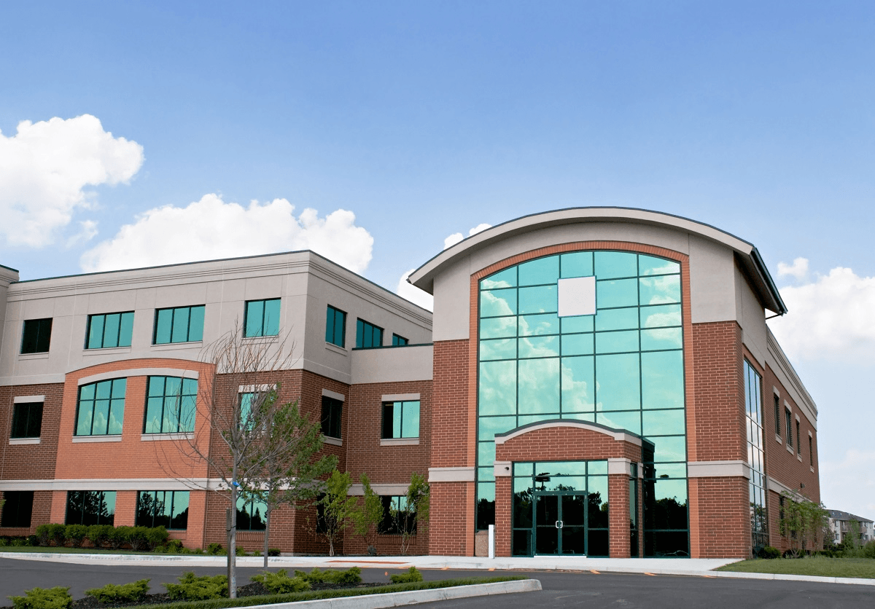
Premises
Short-term (up to 5 years)
Portacabin
Existing building
Rent or buy land
Notes:
Options for premises

Slide 11
Other shops
Wide range of shops
Local produce
Focused people
Community commitment
Volunteers

Slide 12
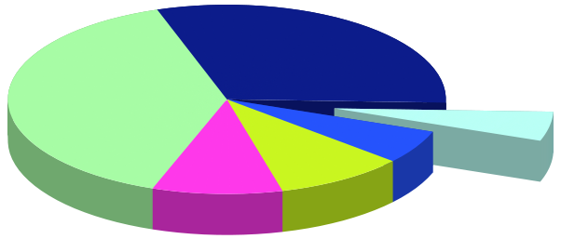
Costs
Set up costs
Building
3 year plan
Potential investors

Slide 13
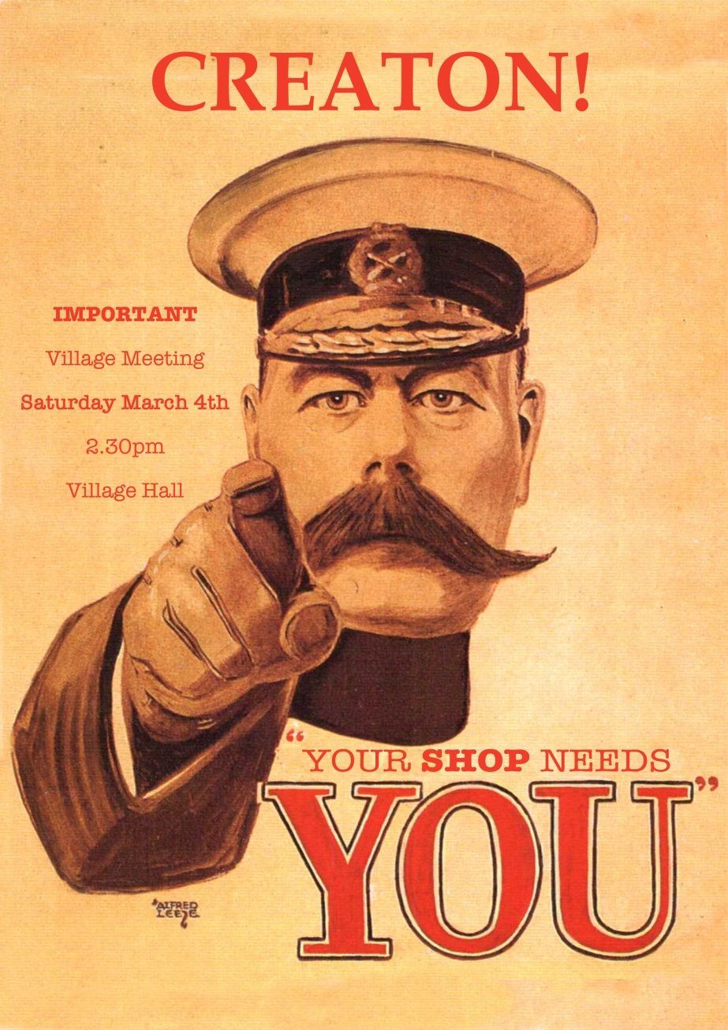
Notes:
All this work was then presented to the village community at a meeting

Slide 14
Presentation to the Community
Vision – in two stages
Building and Location
Business model – Community Benefit Society
Cost of the project
How much need to raise through shares
Pledge

Slide 15
Creaton Community Benefit Society Limited
Overwhelming support
£63,000 in pledges
Became CCBS
via support from Plunkett Foundation

Slide 16
Premises
Notes:
Current building not available
No permanent site available
No suitable building available
No site to rent within Planning conditions
Land offered for 10 year lease, min of 6 years
SIPS building – Structural Integrated Panel Systems
18 week from Go….

Slide 17
Costs
Set Up - £114,000
Building: £85k
F&F: £22k
Other costs: £7k
5-year Finance Plan
Profit & Loss
Cash Flow
Balance Sheet
Plus
Opening cash: £13k and VAT £16.5k

Slide 18
Management Committee
Chair
Treasurer
Society Secretary
Premises
Compliance
Communications
Volunteers
Operations
Parish Council Rep

Slide 19
Where are we now?
Planning permission
Business Plan
Share Launch: £80,000
LEADER application
Volunteers

Slide 20
Post Office
Difficult to pin down
Very supportive
Processes take time

Slide 21
Documents
Business Plan
Share Prospectus
Community Shares Unit
The Hive (Co-operatives UK)
Financial Planning

Slide 22
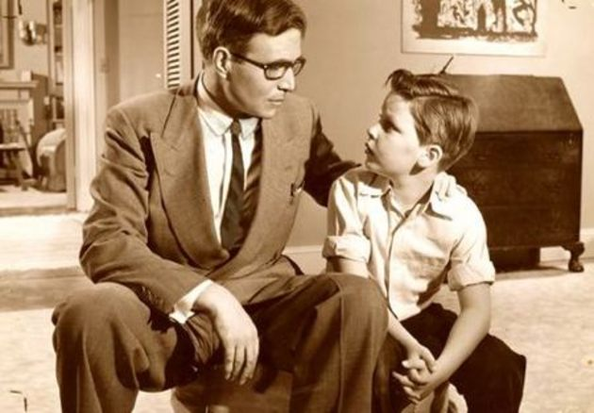
ADVICE

Slide 23
Gather the right people
Talk to Plunkett Foundation
Engage with your community
Have a common hymn sheet
Start process to apply for grants early

Slide 24
Remain positive
Prepare to have it take over your life at some period
Remember why you are doing it
Support each other

Slide 25
Timeline
First met November 17th 2016
Questionnaires out before Christmas
Presentation to the community: March 4th 2017
Share Launch: October 21st
Opening date: Summer 2018?

Slide 26
www.creatonvillageshop.co.uk
Facebook: creatonvillageshop
Twitter: @creatonshop

