Slide 1
Cyber Protect & Fraud Protect

Slide 2
Amie Freeman
David Reed
Neil MacKenzie
cyberprotect@northants.police.uk
fraudprotect@northants.police.uk

Slide 3
Common Misconceptions
Many people do not think that they will ever be affected by cybercrime or fraud, or think that they will not be targeted by scammers
Many people think that you need to be able to remember and identify every single fake email or scam technique to stay safe from criminals
Many people think that Google check all website content to ensure your search results do not contain any scams or fake sites
Many people believe a browser padlock symbol indicates that you are on a genuine and trusted website
Many people believe that someone who contacts them and is seemingly polite and helpful cannot possibly be a scammer
?

Slide 4
Secure an Online Account
Make passwords long and strong (at least 12 characters)
Use capitals, lowercase letters, numbers and symbols
Strong passwords can be made by combining three random words
Don’t use personally relatable names, words or dates
Don’t share passwords with anyone no matter who they claim to be
Always change default passwords on new devices
Use a different password for each account or site
BalloonSawingBurgers
Ba!!oon^^^SawingBurgers
STRONG
VERY STRONG

Slide 5
Affected by a Data Breach?
One or more of your online accounts may have been involved in a data breach where your passwords or other personal details have been leaked
Find out by using the data breach notification site: haveibeenpwned.com to search for any linked account data breaches using your email address
Experian
15,000,000
Yahoo
32,000,000
EasyJet
9,000,000
Amazon
5,000,000
Ebay
145,000,000
Thingiverse
230,000
Coinbase
270,000
Uber
57,000,000
Virgin Media
900,000
Carphone Warehouse
2,400,000
Twitch
10,000,000
Snapchat
1,700,000
Capital One
100,000,000
Dash VPN
1,600,000
Robinhood
5,000,000
Facebook
533,000,000
TalkTalk
157,000
Spotify
500,000
Zoom
500,000
British AIrways
380,000
Vodafone
2,000,000
Petlog
750,000

Slide 6
Secure an Online Account
Enable two-factor-authentication (2FA) on all your important accounts
This adds an extra layer of security to verify genuine account access
Ideally use an authentication app on a trusted device
Keep your operating system, apps and anti virus software up-to-date
Consider using a reputable password manager on all your devices

Slide 7
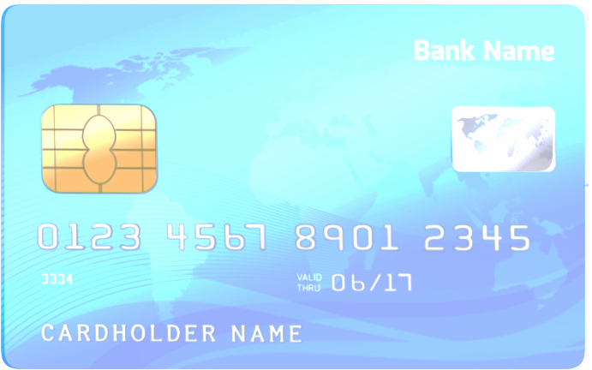
Social Engineering Attacks
Payment details
Your personal details
Your quotes and orders
Your account passwords
Your personal contacts and information
Email messages
Notes:
Introduce Phishing and what it is here …. What motivates an attacker?

Slide 8
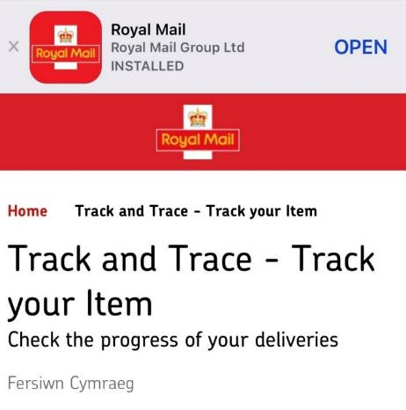
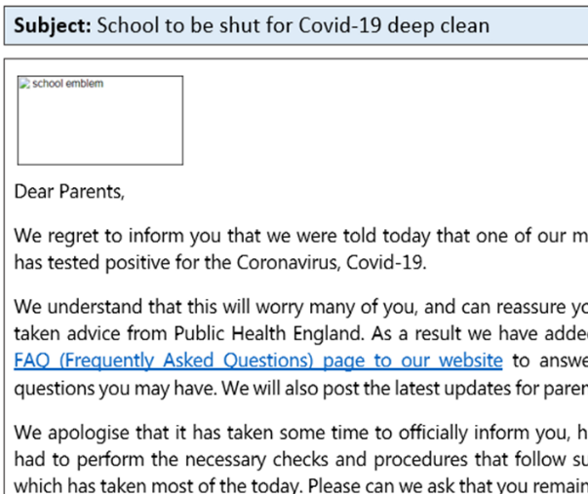
Social Engineering Attacks
Criminals spoof the sender’s address to make emails seem genuine
Real logos, photos and other content are often used to add authenticity
Phishing messages may appear to be from suppliers or services you use
Emails and messages may include your name and other relevant details

Slide 9
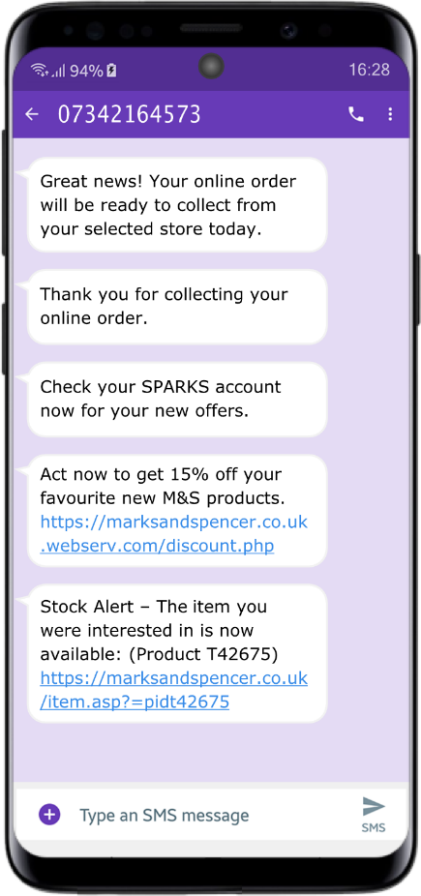
Scam Text Messages
Fraudsters send you texts, WhatsApp and other messages that may be displayed alongside your existing and trusted messages
They may appear to have been sent by an organisation or service you know or trust
Included links will open fake but realistic looking phishing websites or logon pages that are designed to steal your passwords, personal information and payment details
They might also appear to be from friends or family asking for emergency funds; or for invoices, bills or fines to be paid or gifts purchased

Slide 10
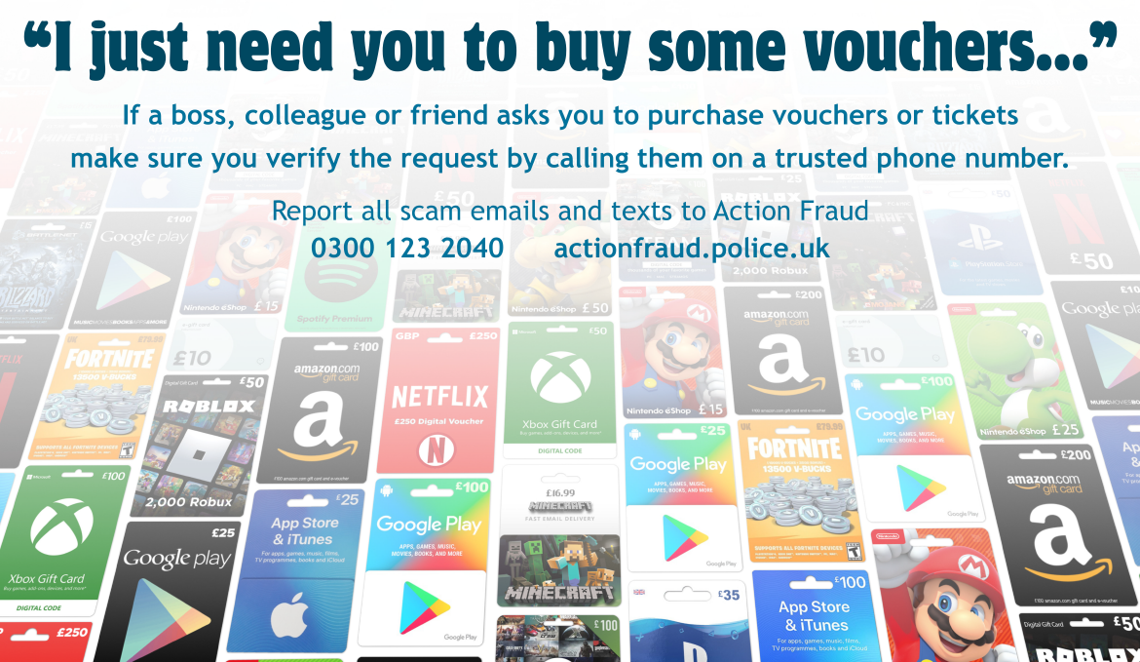
CEO/Voucher Fraud
Emailed messages appear to be from someone you know or trust
The message may copy the content and style you are familiar with

Slide 11
Payment Diversion/Invoice Fraud
Fraudsters send emails containing modified invoices and quotes, or discount offers, for genuine work or services
They may also email you impersonating a genuine customer, supplying new payment details or a delivery location for an existing and valid order
Spoofed email addresses, real logos and other details are often used to make them appear to be from your real customers, suppliers and staff
Always take time to review and confirm payment changes using another trusted means of contact, such as via a verified phone number and contact already held on file

Slide 12
Protecting Your Devices
Malware can infect computers, phones, tablets and smart/IoT devices
Viruses, spyware, worms, Trojans and ransomware are the most common types of malware
Spyware might secretly monitor your typing, mouse movements, web browsing and location or turn on your device’s camera and microphone
Ransomware silently encrypts your computer documents and photos before demanding payment to decrypt and recover the data
Organisations, schools and charities are especially at risk from ransomware with cyber criminals making use of remote working

Slide 13
Protecting Your Devices
Ensure default passwords have been changed on your network router, smart devices and any Internet connected cameras, toys or games
Secure your phones and tablets using a password and/or biometric lock
Always keep your devices, apps and other software up-to-date
If available, enable auto-updates on your computer, phone and tablet
Use a reputable and regularly updated Anti Virus package on your PC
Regularly backup all your important documents, photos and videos

Slide 14
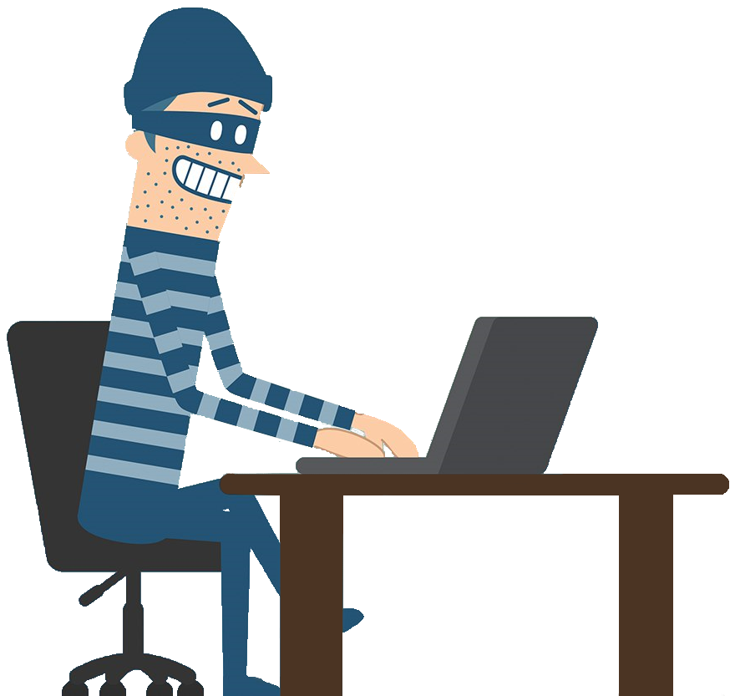
Computer Software Service Fraud
Fraudsters phone you, purporting to be IT support or that they are calling on behalf of your computer, phone, software or Internet provider
They will claim that they have identified problems with your device or Internet connection which need fixing immediately, and can be extremely convincing and manipulative
Then instruct you to change settings, press certain keys or download remote access software such as TeamViewer
Pop-up messages or alerts may also appear, claiming to have detected viruses or other security issues, with instructions to call a fake service line for support

Slide 15
Romance Fraud
Does the person you are speaking to-
Claim to live or work abroad
Pressure you to move away from the website/app where you first met
Tell you to hide your relationship from friends and family
Constantly make excuses why they can’t meet in person
Appear vulnerable, emotional and in desperate need of your help
May encourage you to offer financial support to them or their family
Ask you for money, donations or items to be purchased

Slide 16
Is your perfect match really who they say they are?
If you think you have been a victim, don’t feel ashamed or embarrassed – you are not alone.

Slide 17
Courier Fraud
Fraudsters call you purporting to be the police, bank or other organisation, claiming to be part of an ongoing investigation where they need you to withdraw cash or purchase goods before handing them over to a ‘courier’ via an arranged appointment
They will promise you the money or items you hand over will be reimbursed or returned when in reality there will be no further contact
The fraudster may already know some basic details about you such as your name and address or items/services that you have purchased
A genuine police officer or organisation will never contact you to ask you to aid an investigation by withdrawing cash or purchasing goods.

Slide 18
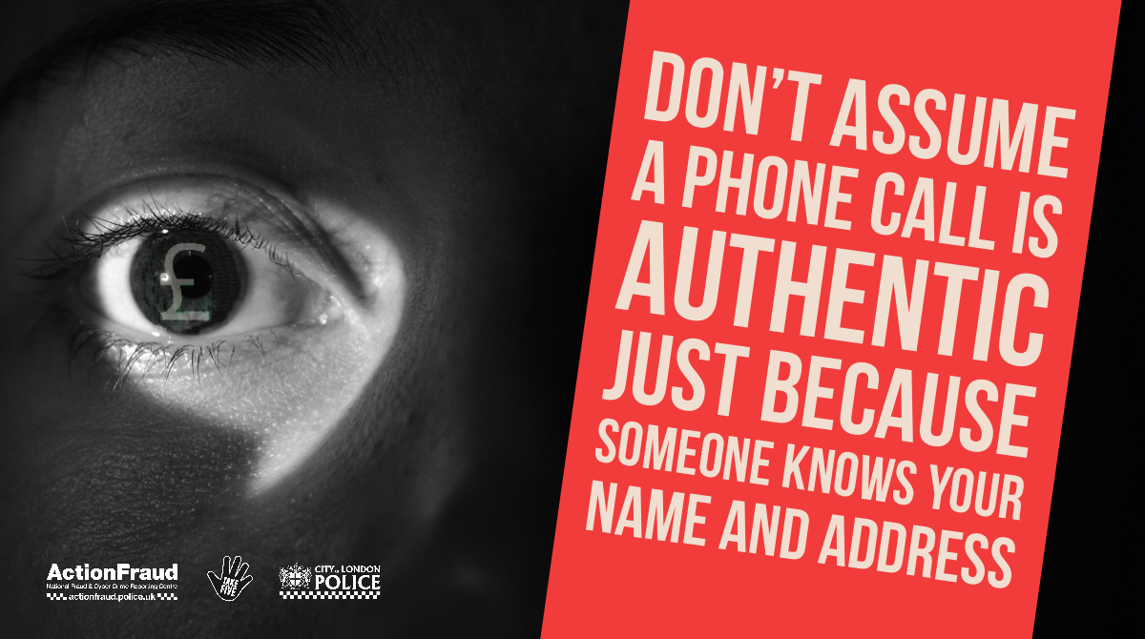
Courier Fraud
If you receive one of these calls, end it immediately and report it to the Police or Action Fraud
To verify a Police Officer’s identity contact your local force by dialling 101
To verify other caller’s identity contact their organisation via another trusted means

Slide 19
Safer Online Shopping
Avoid clicking sponsored links or adverts in your search results
Check the web address carefully to ensure you visit the genuine website
If the store or website is not well known carry out research
Avoid social media posts offering vouchers and coupons unless verified
Minimise personal information given when setting-up a store account
Use a credit card or trusted payment provider when purchasing online
Never accept requests to pay by bank transfer or PayPal Friends & Family
Always remember to sign out of the account when finished

Slide 20
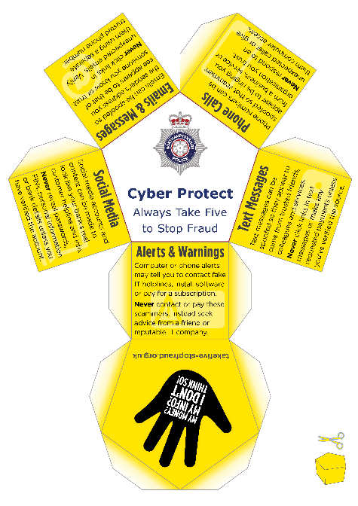
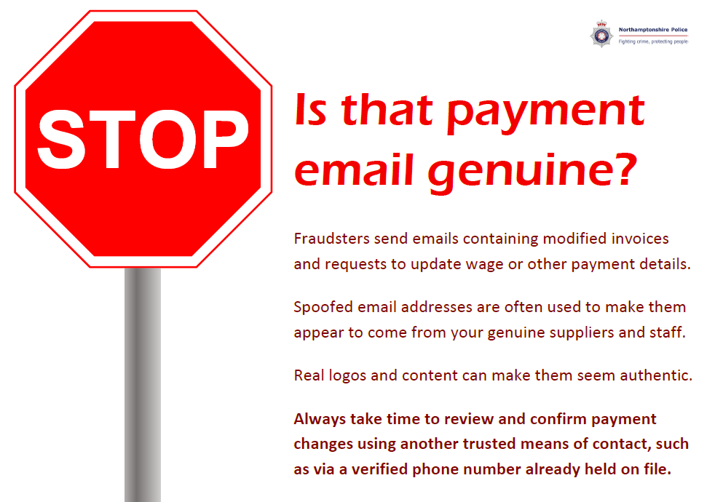
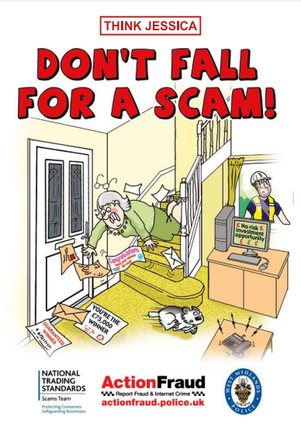
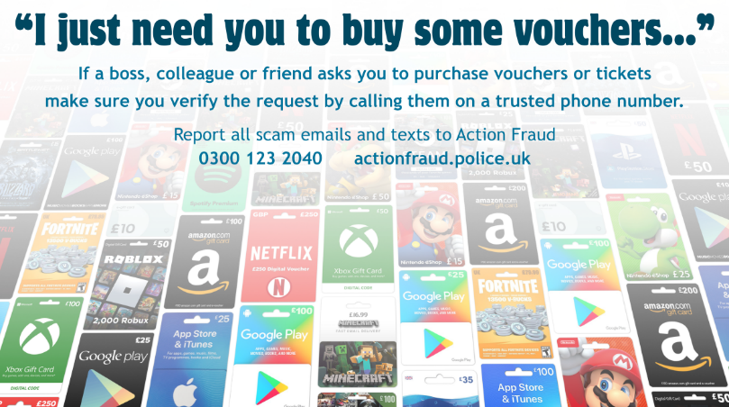
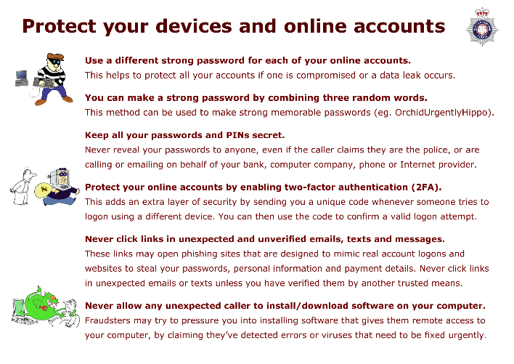
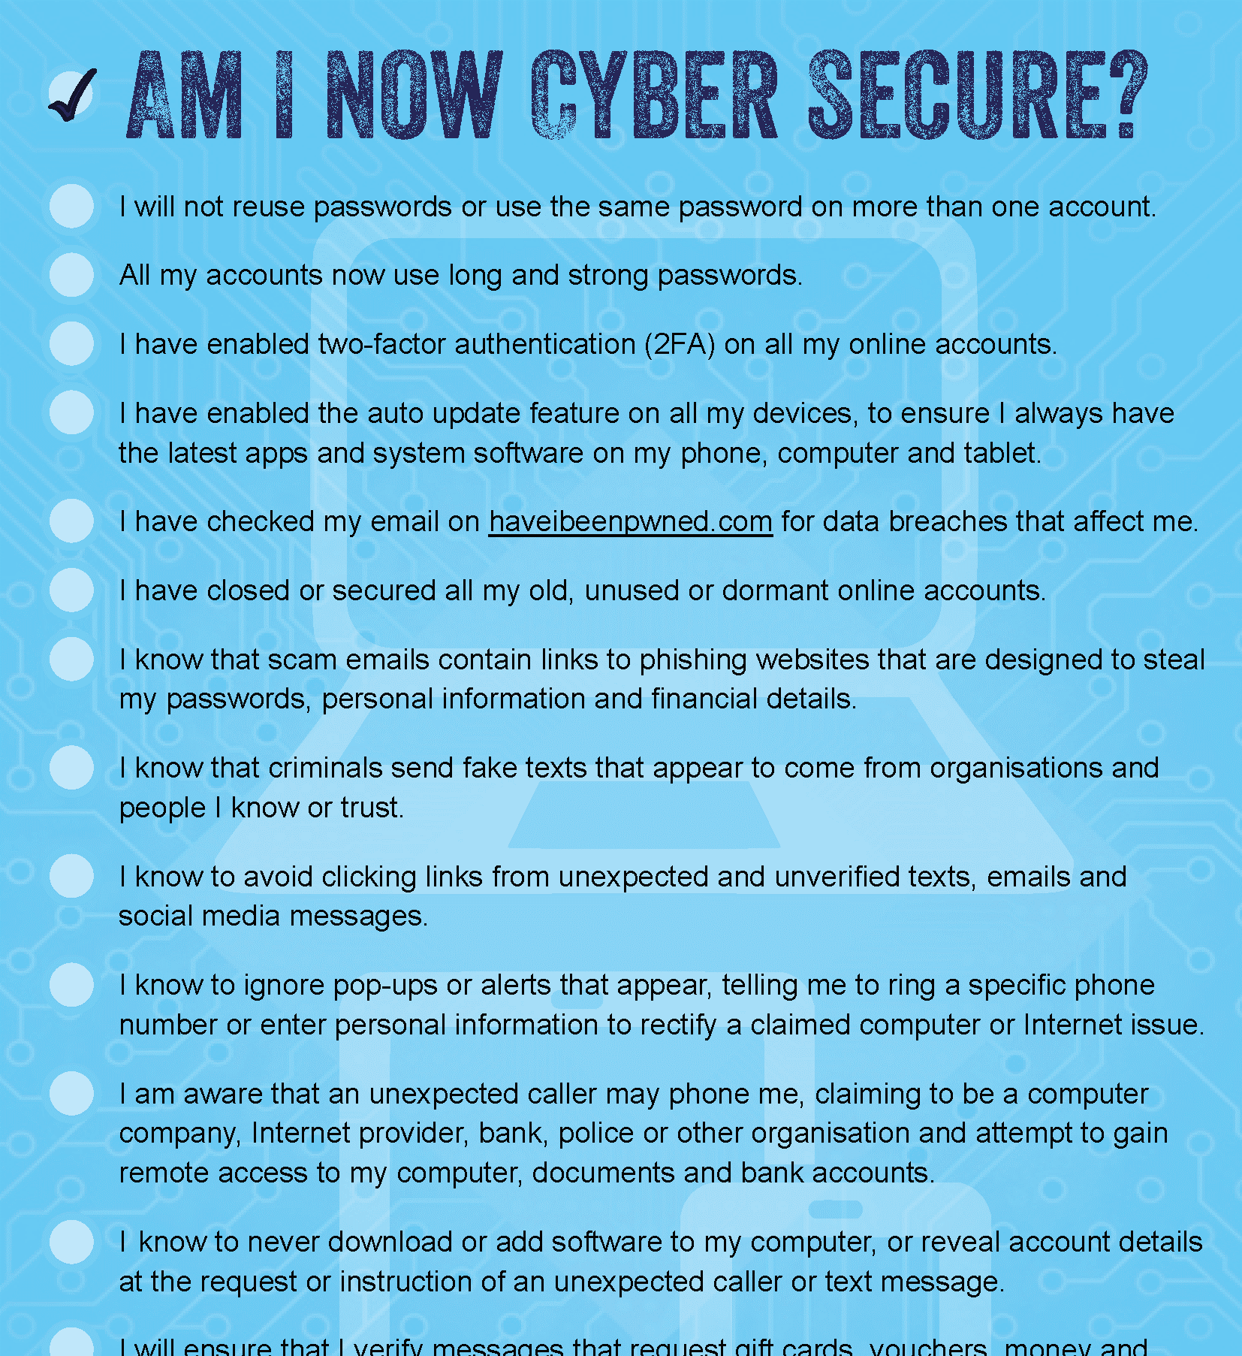
Free Resources

Slide 21
Amie Freeman
David Reed
Neil MacKenzie
cyberprotect@northants.police.uk
fraudprotect@northants.police.uk
Report all Cybercrime and Fraud to
Action Fraud 0300 123 2040

